Slide 1
Synthetic Financial Datasets for Fraud Detection

Slide 2
In this project, I worked on analyzing a synthetic financial transactions dataset to identify fraudulent activities. The goal was to simulate real-world fraud detection by applying SQL queries and advanced techniques.
Key tasks included:
Comparing fraudulent vs. non-fraudulent transactions (average amounts, percentages).
Identifying high-risk accounts with the largest transaction volumes.
Detecting money laundering patterns using recursive CTEs.
Tracking fraudulent activity trends over time with rolling calculations.
Using multiple CTEs to flag suspicious behaviors such as consecutive unchanged balances and unusually large transfers.
Validating balances to check for discrepancies in updated balances.
Highlighting transactions where accounts had a zero balance before or after transfers.
This project demonstrates my ability to work with large datasets, write complex SQL queries, and apply analytical thinking to detect fraud patterns—skills directly relevant for a Data Analyst / Fraud Analytics role.

Slide 3
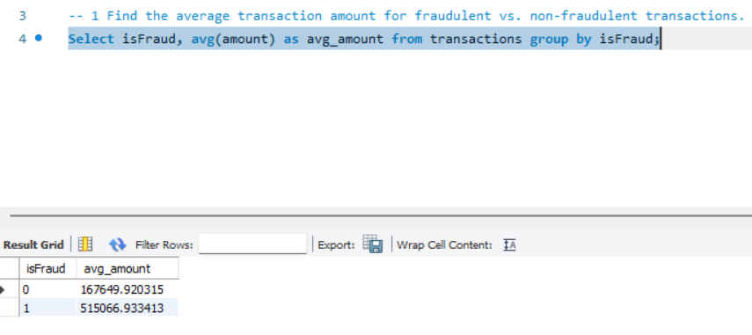
1- Find the average transaction amount for fraudulent vs. non-fraudulent transactions.

Slide 4
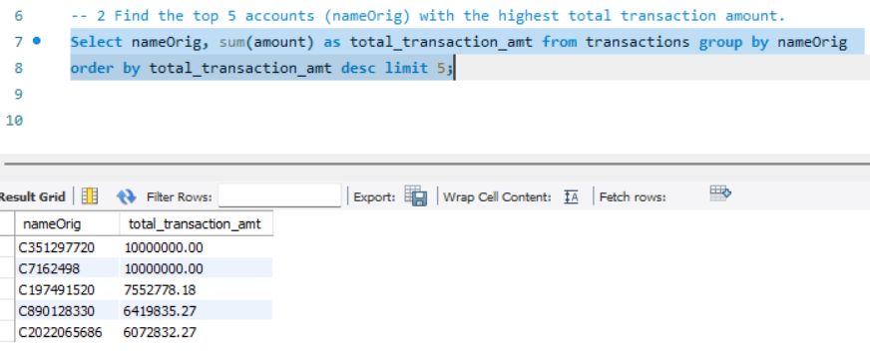
2- Find the top 5 accounts (nameOrig) with the highest total transaction amount.

Slide 5
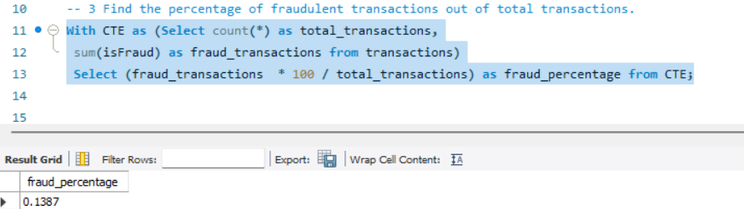
3- Find the percentage of fraudulent transactions out of total transactions.

Slide 6
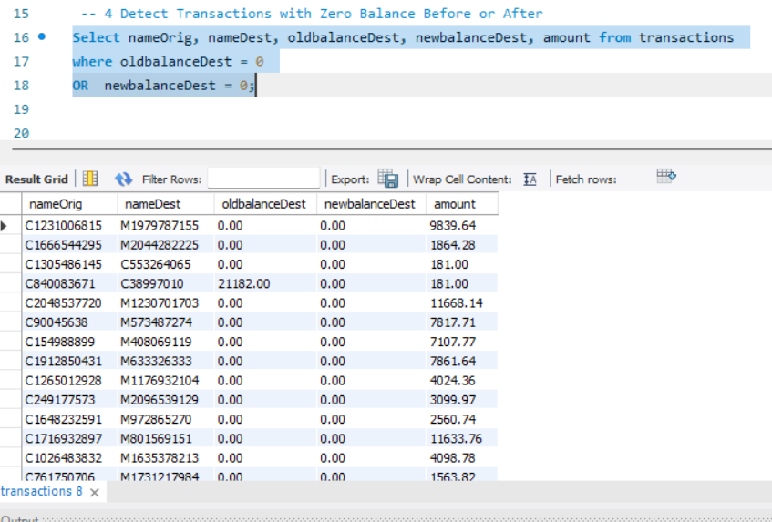
4. Detect Transactions with Zero Balance Before or After
Question: Find transactions where the destination account had a zero balance before or after the transaction.
SQL Prompt: Write a query to list transactions where oldbalanceDest or newbalanceDest is zero.

Slide 7
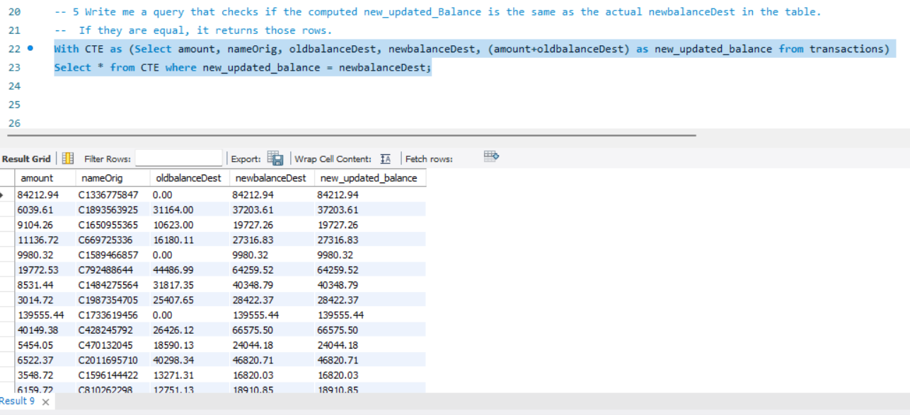
5. Write me a query that checks if the computed new_updated_Balance is the same as the actual newbalanceDest in the table. If they are equal, it returns those rows.

Slide 8
6. Detecting Recursive Fraudulent Transactions
Question: Use a recursive CTE to identify potential money laundering chains where money is transferred from one account to another across multiple steps, with all transactions flagged as fraudulent. This query uses a recursive CTE to track the flow of money through multiple accounts over successive steps. The recursive part of the CTE allows us to follow the chain of transactions and identify patterns that could indicate money laundering activities. It filters out chains where all transactions are marked as fraudulent.

Slide 9
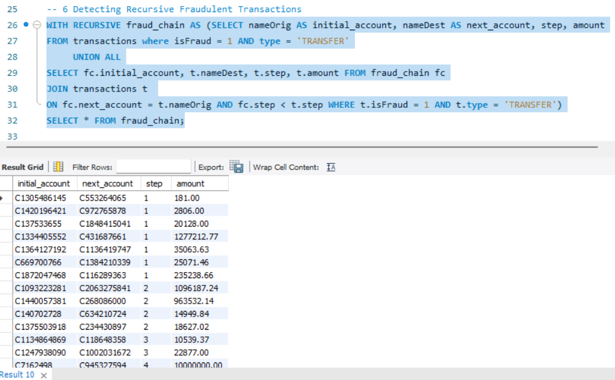

Slide 10
7. Analyzing Fraudulent Activity over Time
Question: Use a CTE to calculate the rolling sum of fraudulent transactions for each account over the last 5 steps.
Solution: This query uses a CTE to calculate the cumulative sum of fraudulent transactions for each account over the last five steps. It helps in understanding the temporal distribution of fraudulent activities, which is crucial for identifying patterns over time.

Slide 11
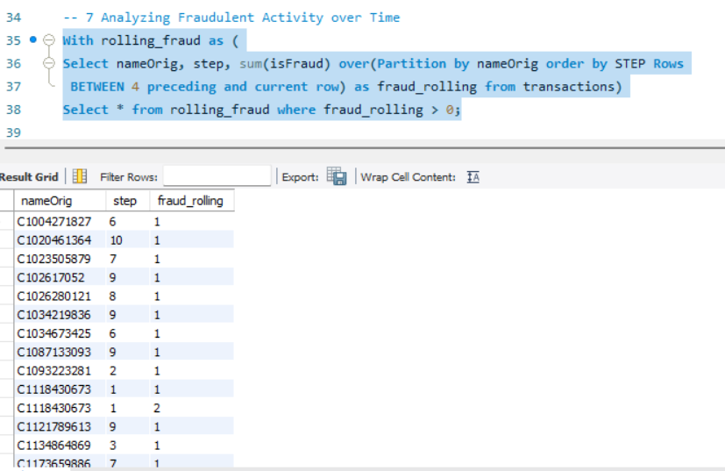

Slide 12
8. Complex Fraud Detection Using Multiple CTEs
Question: Use multiple CTEs to identify accounts with suspicious activity, including large transfers, consecutive transactions without balance change, and flagged transactions. Solution: This query combines multiple suspicious criteria using multiple CTEs. It identifies accounts involved in large transfers, followed by no balance changes, and also where at least one transaction was flagged. The result is a list of highly suspicious accounts for further investigation.

Slide 13
